Slide 1
Lecture 5 Developing a project plan
Contents
What is a Project network?
Why is project network needed?
How to develop a project network?
How to compute a project time?
How to make the network close to reality?

Slide 2
What is a project network?
Project network is a flow chart that graphically depicts the sequence, interdependencies, and start and finish times of the project activities
Project activities are the individual actions that must be completed to achieve project success

Slide 3
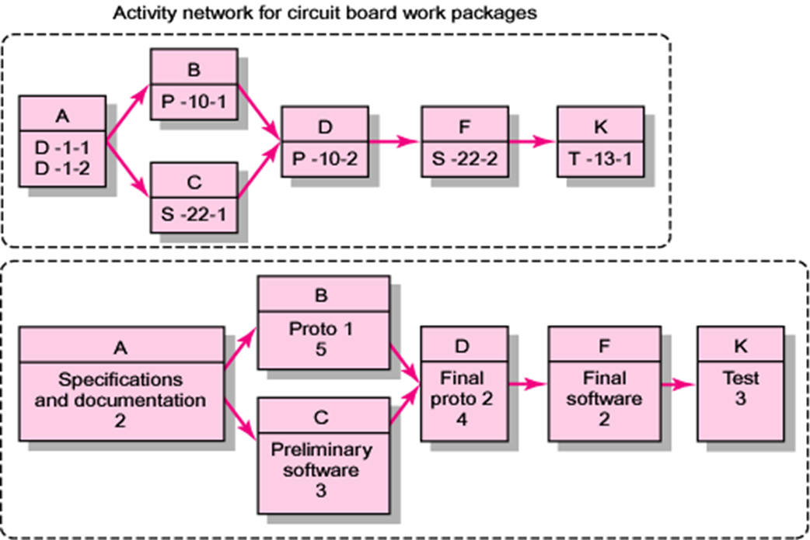
What is a project network
Activity - On - Node

Slide 4
What is a project network
Activity - On - Arrow
E
I
B
G
A
C
K
L
D
H
F

Slide 5
Why is project network needed?
Develop a project time plan which includes:
- Sequence of activities
- Start and finish time
- Project duration
Develop other project resource plans including:
- Human resource
- Physical resource
- Financial resource
- Outsourcing

Slide 6
How to develop a project network?
Terminology
Basic rules for constructing a project network
Two Approaches in constructing a project network

Slide 7
Terminology
Activity: an element of the project that requires time
Activity – on – Node: Uses a node to depict an activity
- ES: Early start
- EF: Early finish
- LS: Late start
- LF: Late finish
- SL: Slack time = LS – ES or LF - EF
ES
Label
EF
SL
Activity name
LS
Duration
LF

Slide 8
Terminology
Activity – on – Arrow: Uses an arrow to depict an activity
Name or Label
(Duration, resources)
Start
Finish
Direction from left to right

Slide 9
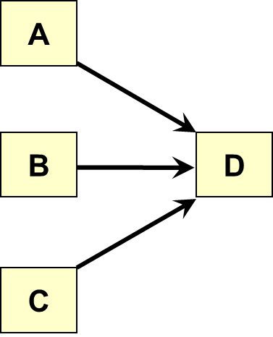
Terminology
Merge activity: an activity that has two or more preceding activities on which it
depends
Parallel (concurrent) activities: Activities that can occur independently and, if
desired, not at the same time.

Slide 10
Terminology
Path: a sequence of connected, dependent activities
Critical path: the longest path through the activity network that allows for the completion of all project-related activities. The shortest expected time in which the entire project can be completed. Delays on the critical path will delay completion of the entire project.
E
B
A
F
C
I
K
D
H
G
A – B – E – K
A – B – F – I – K
A – C – I – K
A – D – G – H - K

Slide 11
Terminology
Event: a point in time when an activity is started or completed.
Dummy activity: The activity that does not consume time.
Burst activity: an activity that has more than one activity immediately following
it (more than one dependency arrow flowing from it).
B
A
C
D

Slide 12
Basic rules for constructing a project network
Networks typically flow from left to right
An activity cannot begin until all of its preceding activities are complete
Arrows indicate precedence and flow and can cross over each other
Identify each activity with a unique number; this number must be greater than its predecessors
Looping is not allowed

Slide 13
Two Approaches in constructing a project network
Activity – On – Node (AON): Uses a node to depict an activity
Activity – On – Arrow (AOA): Uses an arrow to depict an activity

Slide 14
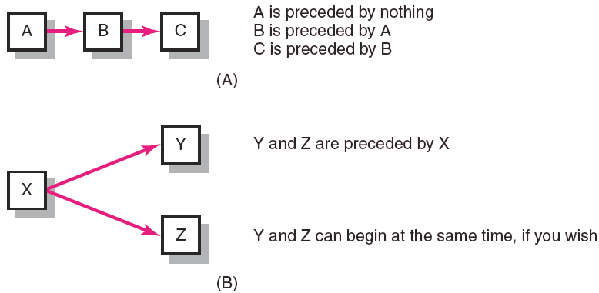
Activity – on – node (AON)
Fundamentals for developing a project network by AON

Slide 15
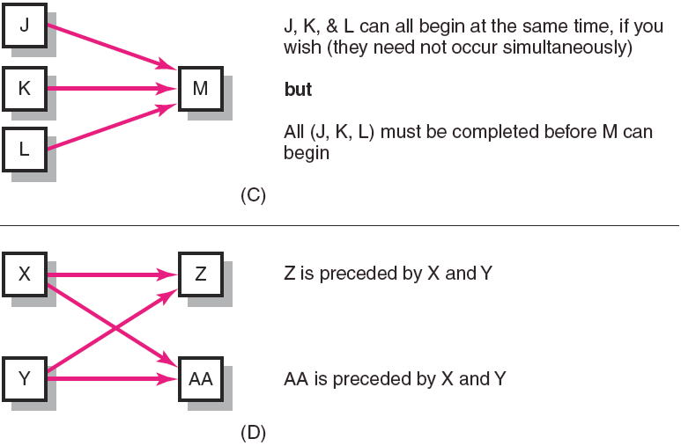
Activity – on – node (AON)
Fundamentals for developing a project network by AON

Slide 16
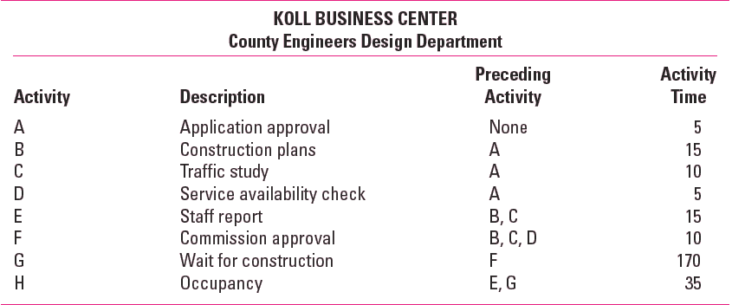
Activity – on – node (AON)
Network information

Slide 17
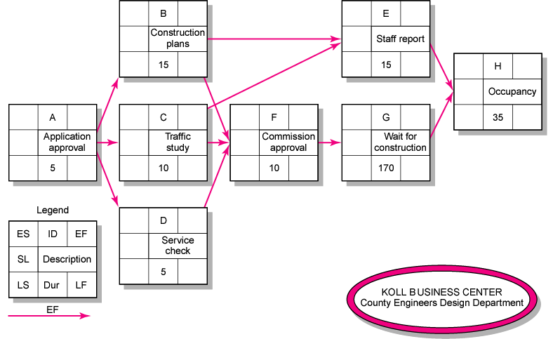
Activity – on – node (AON)

Slide 18
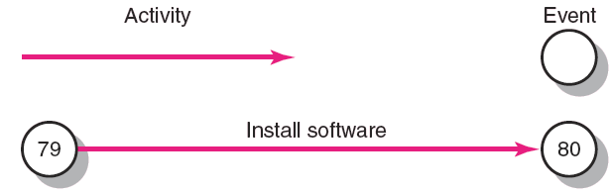
Activity – on – arrow (AOA)
Fundamentals for developing a project network by AOA
Dummy Activity

Slide 19
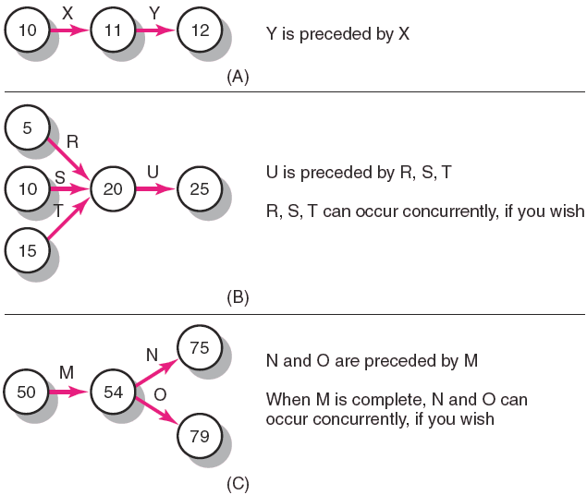
Activity – on – Arrow (AOA)
Fundamentals for developing a project network by AOA

Slide 20
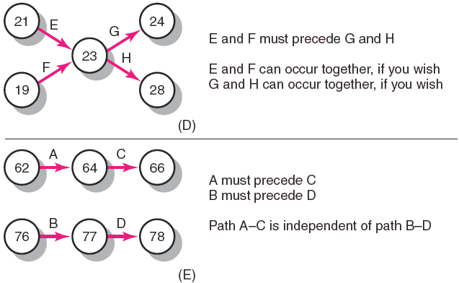
Activity – on – Arrow (AOA)
Fundamentals for developing a project network by AOA

Slide 21
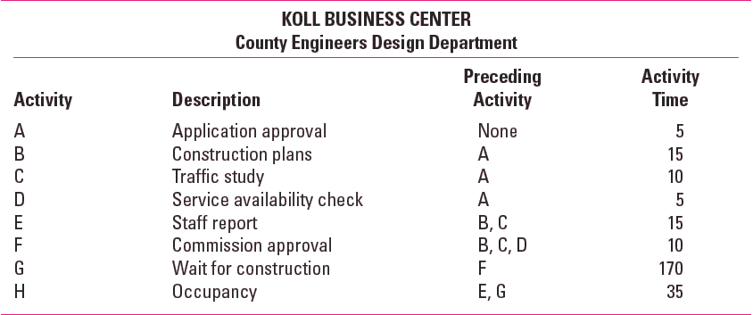
Activity – on – Arrow (AOA)
Network information

Slide 22
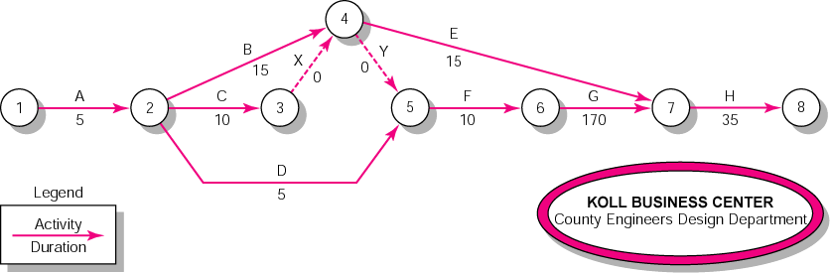
Activity – on – Arrow (AOA)

Slide 23
How to Compute a project time?
Network computation process
AON case
AOA case

Slide 24
Network computation process
Forward Pass Computation
Backward Pass Computation
Determining slack time

Slide 25
Forward Pass Computation
Start from the left and go to the right of the network
Add activity times along each path in the network (ES + Duration = EF).
Carry the early finish (EF) to the next activity where it becomes its early start (ES) unless the next succeeding activity is a merge activity, in which case the largest EF of all preceding activities is selected.
Where:
- ES (Early start): How soon can the activity start?
- EF (Early finish): How soon can the activity finish?
- ET (Expected time): How soon can the project finish?

Slide 26
Backward Pass Computation
Start from the right and go back to the left of the network
Subtract activity times along each path in the network (LF - Duration = LS).
Carry the late start (LS) to the next activity where it becomes its late finish (LF) unless the next succeeding activity is a burst activity, in which case the smallest LF of all preceding activities is selected
Where:
- LS (Late start): How late can the activity start?
- LF (Late finish): How late can the activity finish?
SL (Slack time or flow): How long can it be delayed?

Slide 27
Backward Pass Computation
Free Slack (or Float)
The amount of time an activity can be delayed without delaying connected successor activities
Total Slack
The amount of time an activity can be delayed without delaying the entire project
The critical path is the network path(s) that has (have) the least slack in common.

Slide 28
Activity – on – node (AON)
Network information

Slide 29
Activity – on – node (AON)

Slide 30
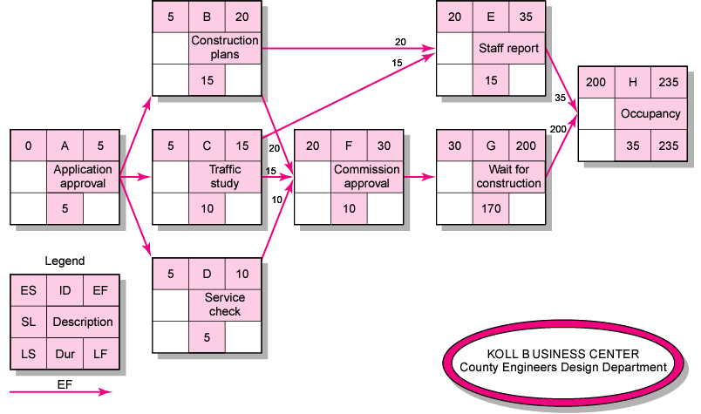
Activity – on – node (AON)
Forward pass computation

Slide 31
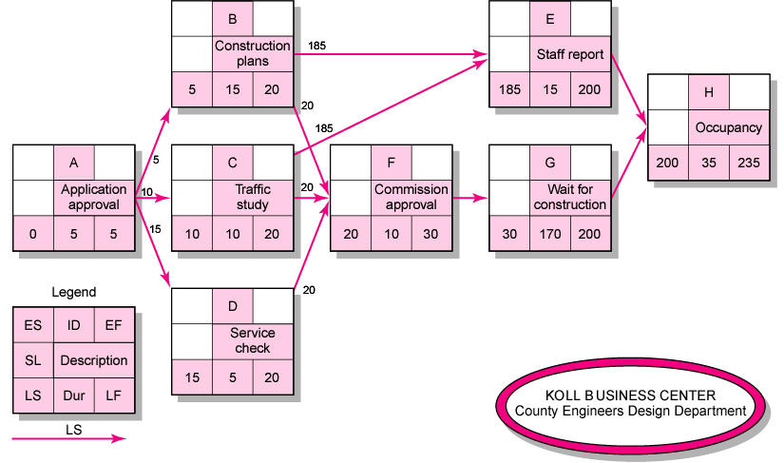
Activity – on – node (AON)
Backward pass computation

Slide 32
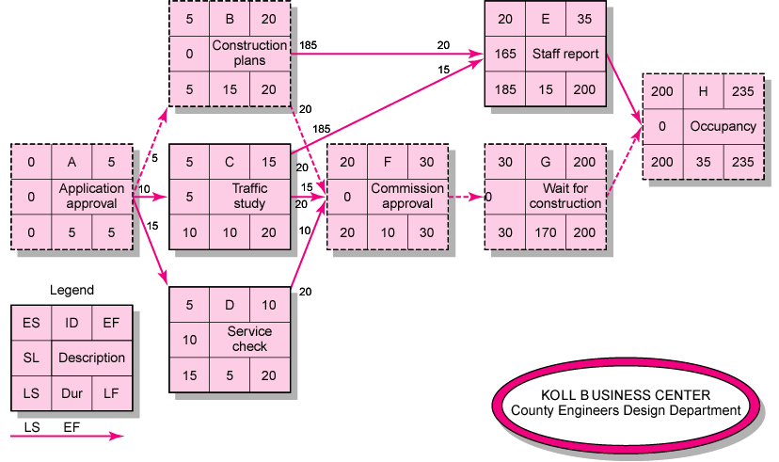
Activity – on – node (AON)
Network with slack time

Slide 33
Activity – on – node (AOA)
Network information

Slide 34
Activity – on – node (AOA)

Slide 35
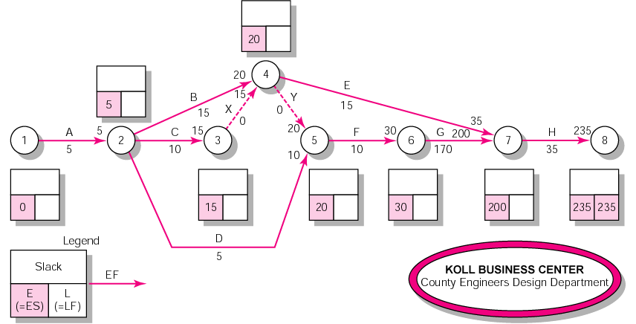
Activity – on – node (AOA)
Forward pass computation

Slide 36
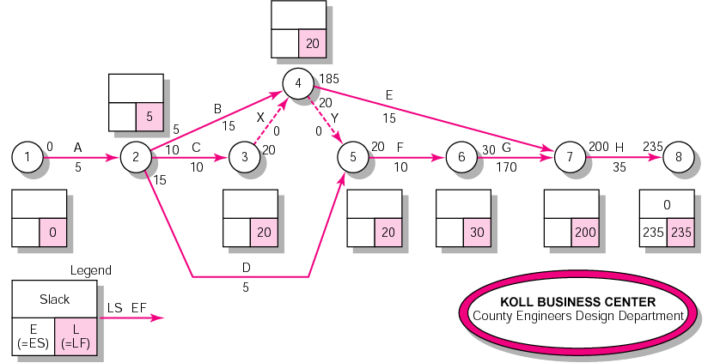
Activity – on – node (AOA)
Backward pass computation

Slide 37
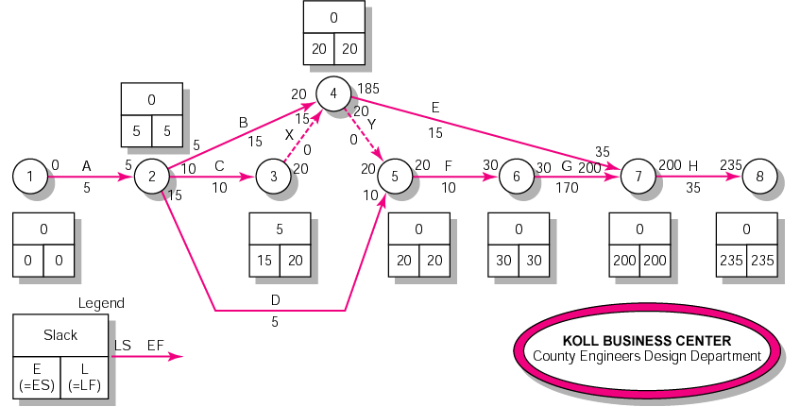
Activity – on – node (AOA)
Network with slack time

Slide 38
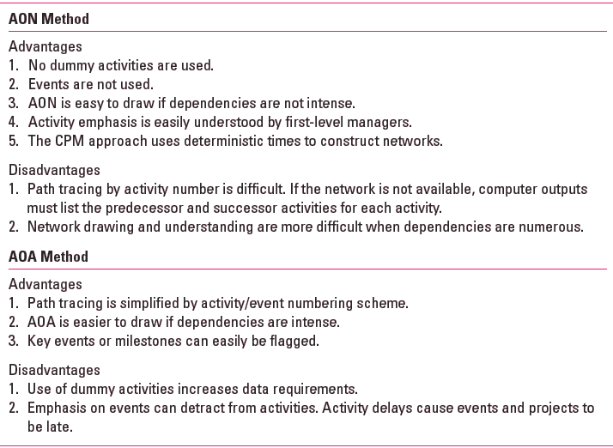
Comparison of AON and AOA Methods

Slide 39
How to make the network close to reality?
Laddering technique
Activities are broken into segments so the following activity can begin sooner and not delay the work.
Lagging technique
The minimum amount of time a dependent activity must be delayed to begin or end
Lengthy activities are broken down to reduce the delay in the start of
successor activities.
Lags can be used to constrain finish-to-start, start-to-start, finish-to-finish,
start-to-finish, or combination relationships.

Slide 40
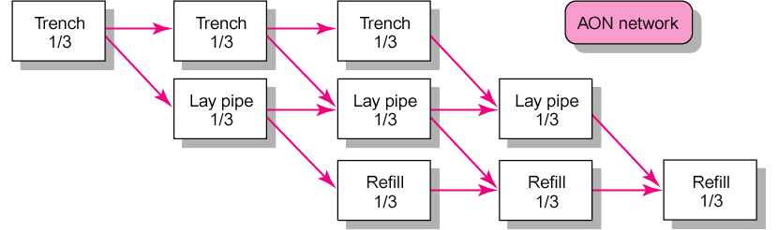
Laddering technique

Slide 41
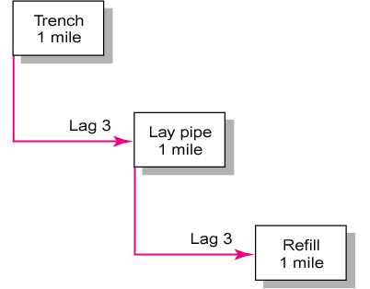
Lagging technique

Slide 42
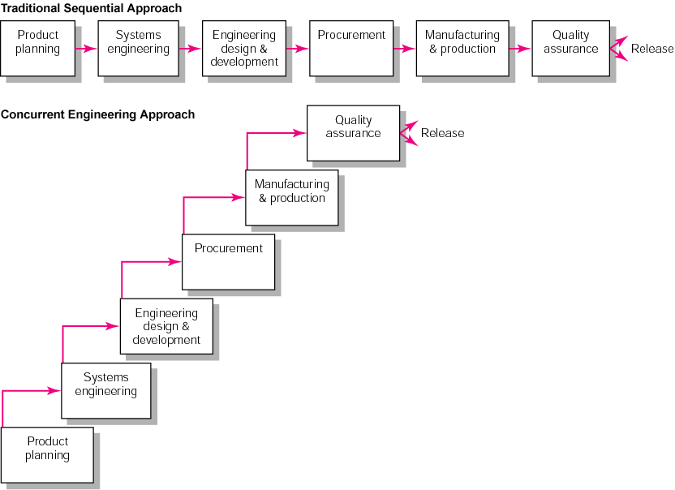
Lagging technique

Slide 43
Key Terms
Activity
Activity-on-arrow (AOA)
Activity-on-node (AON)
Burst activity
Concurrent engineering
Critical path
Early and late times
Gantt chart
Hammock activity
Lag relationship
Merge activity
Network sensitivity
Parallel activity
Slack/float—total and free

Slide 44
You are required to develop a project network and compute the project time using two approaches: AON and AOA
Activity | Preceding activity | Activity time (Week) | Workforce (Persons/week) | Machine (Unit/week)
A | None | 2 | 5 | 2
B | None | 1 | 6 | 2
C | None | 3 | 3 | 5
D | A | 2 | 4 | 6
E | B, D | 4 | 5 | 4
F | B, D | 5 | 8 | 3
G | C, E | 6 | 6 | 1

Slide 45
You are required to develop a project network and compute the project time using two approaches: AON and AOA
0 | A | 2 |  | 2 | D | 4 |  |  | 4 | F | 9
0 |  |  |  | 0 |  |  |  |  | 5
0 | 2 | 2 |  | 2 | 2 | 4 |  |  | 9 | 5 | 14
0 | B | 1 |  |  |  |  |  |  | 4 | E | 8
3 |  |  |  |  |  |  |  |  | 0
3 | 1 | 4 |  |  |  |  |  |  | 4 | 4 | 8
 |  |  |  |  |  |  |  |  |  |  |  |  | 8 | G | 14
0 | C | 3 |  |  |  |  |  |  |  |  |  |  | 0
5 |  |  |  |  |  |  |  |  |  |  |  |  | 8 | 6 | 14
5 | 3 | 8

Slide 46
You are required to develop a project network and compute the project time using two approaches: AON and AOA
2
4
2
4
4
2
D(2)
2
9
A(2)
1
4
0
B(1)
4
F(5)
4
3
E(4)
9
0
8
14
0
8
0
C(3)
3
8
G(6)
14
5
8
8
14

